Slide 1


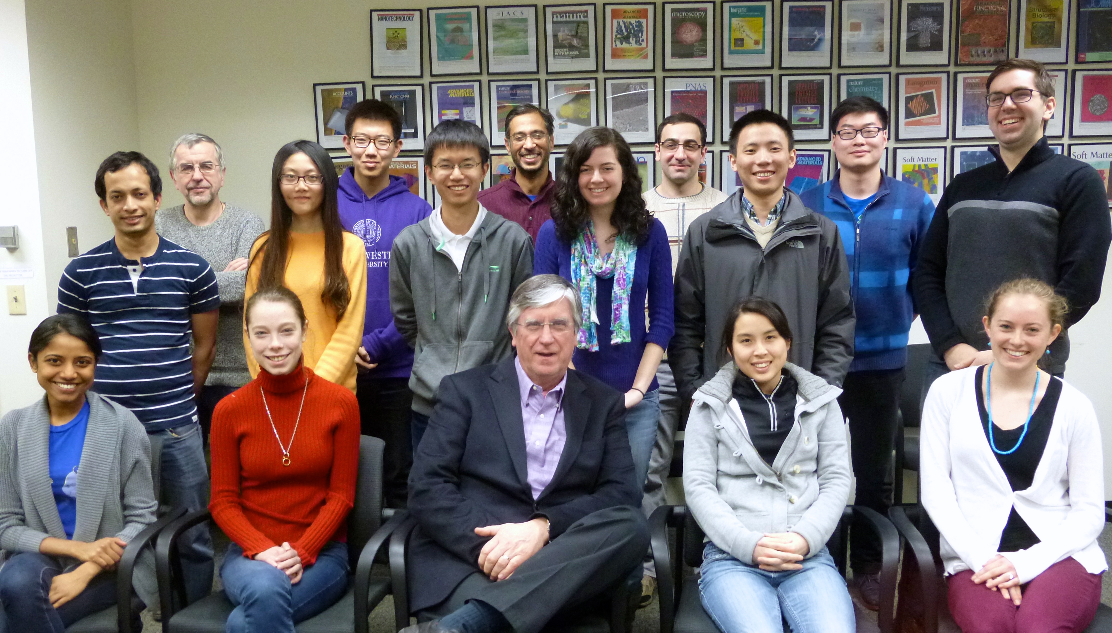
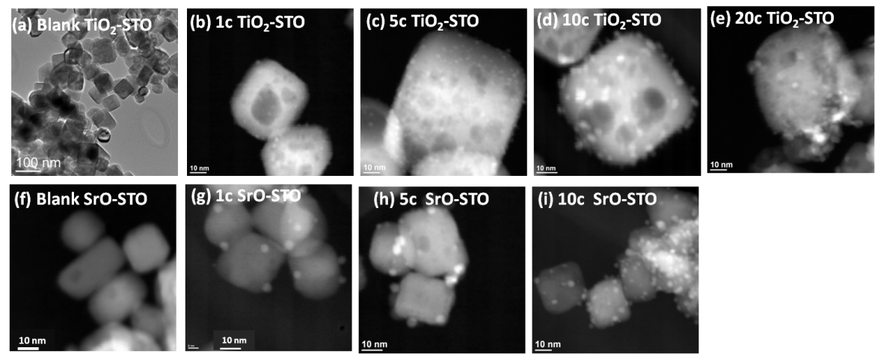
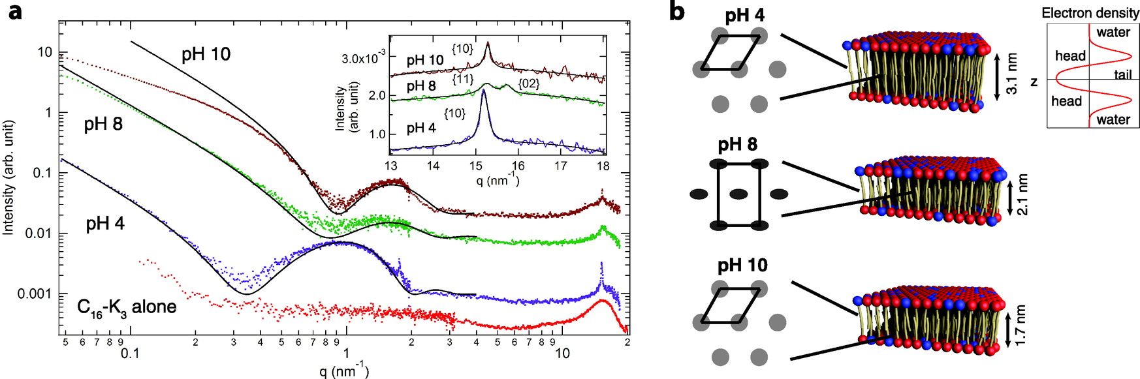
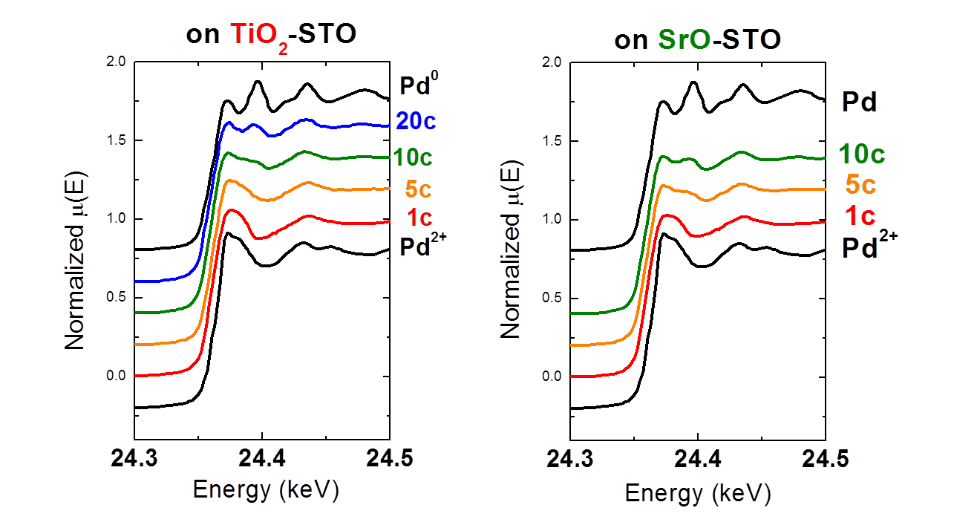

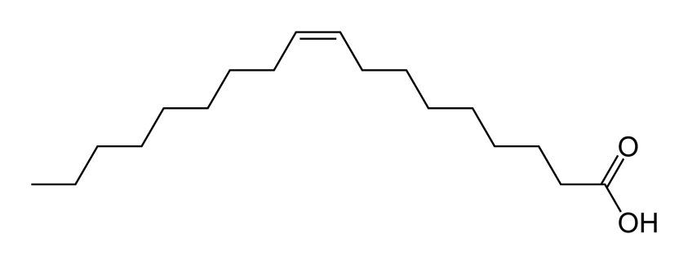
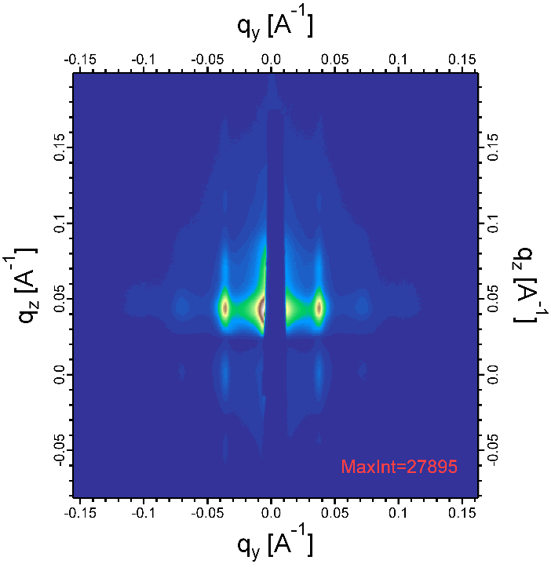
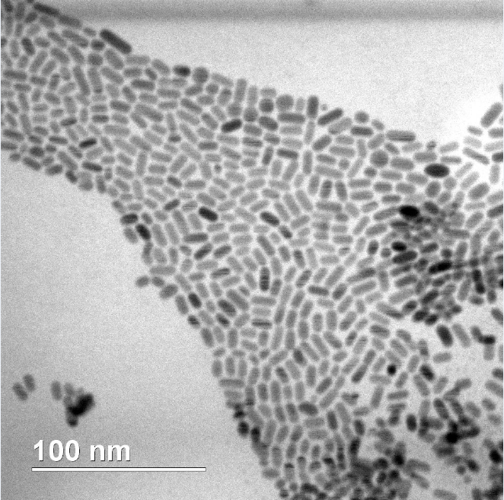
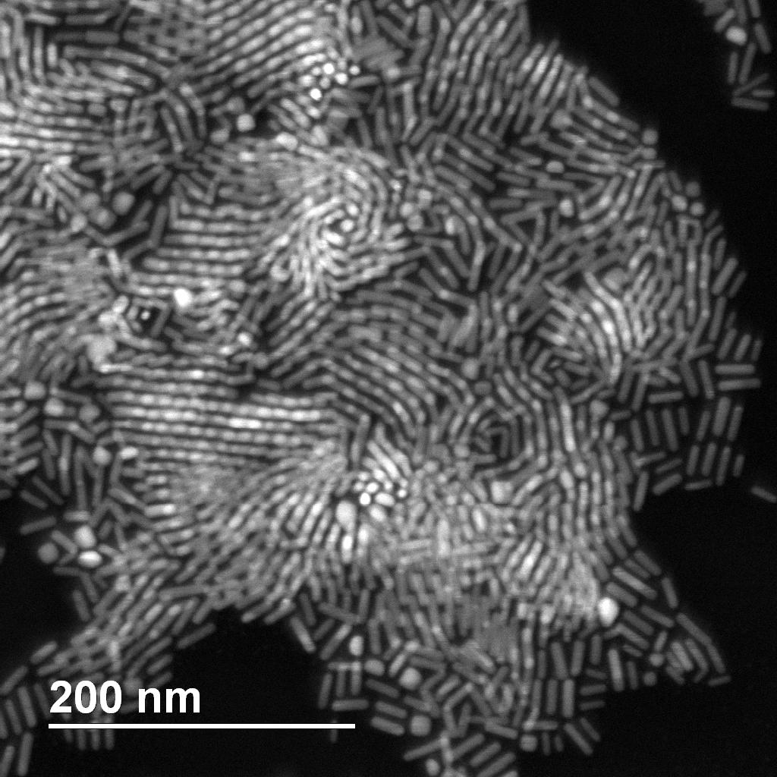
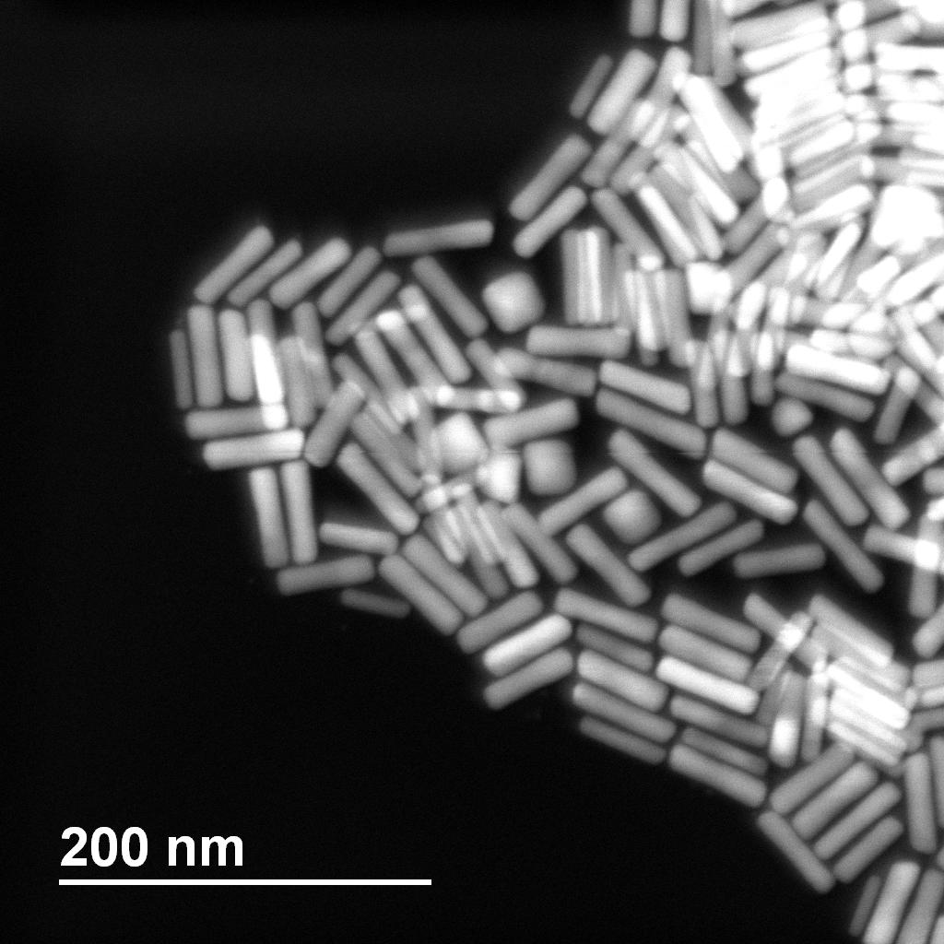
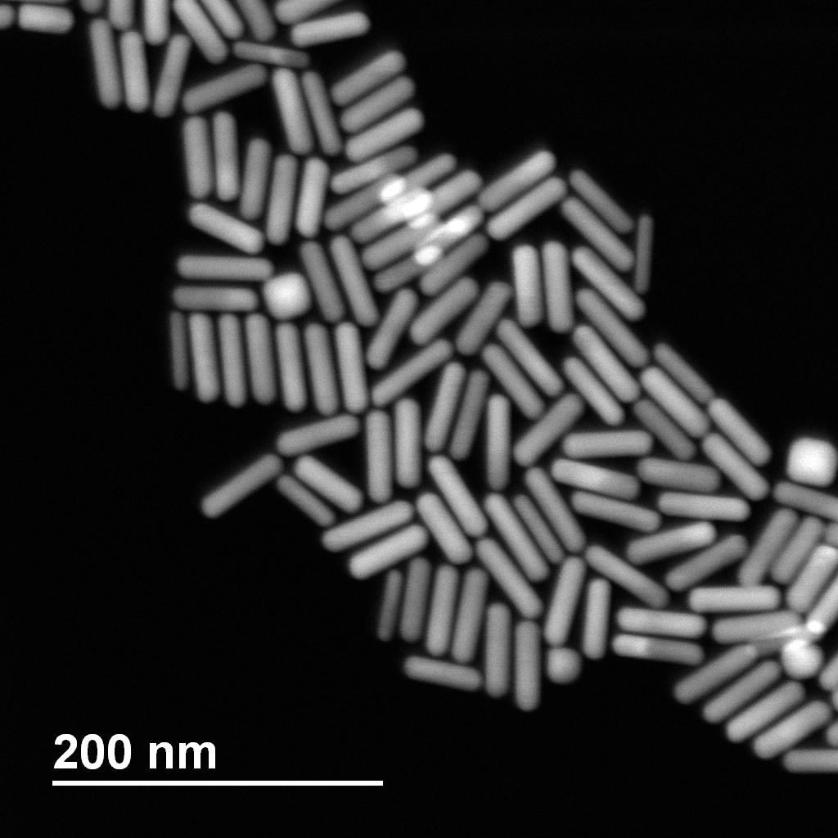
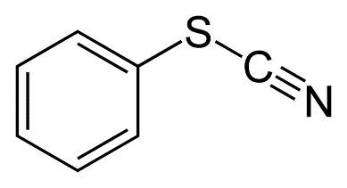
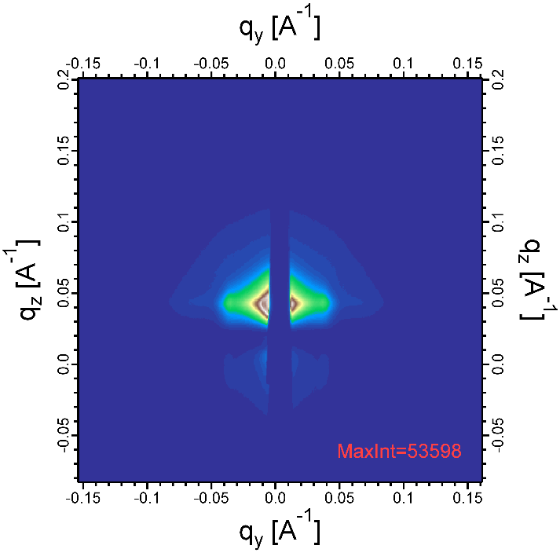
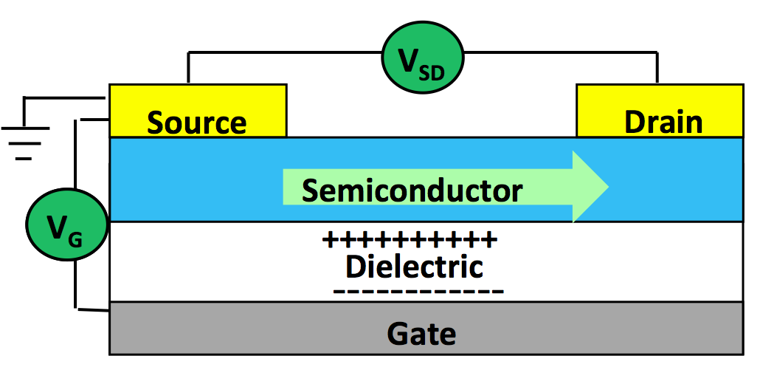
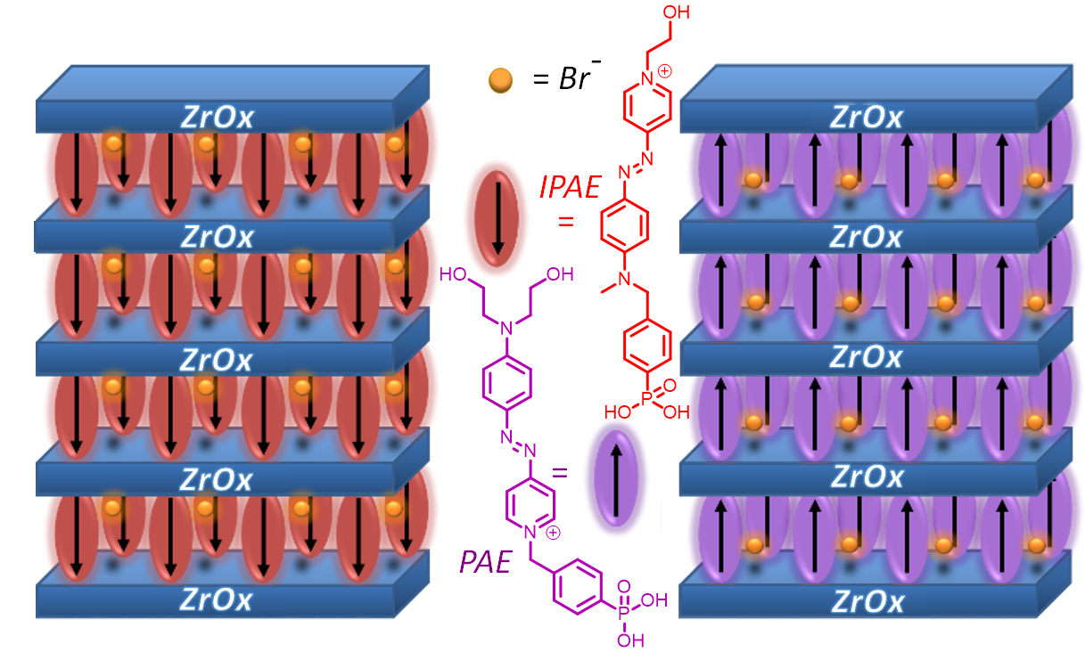
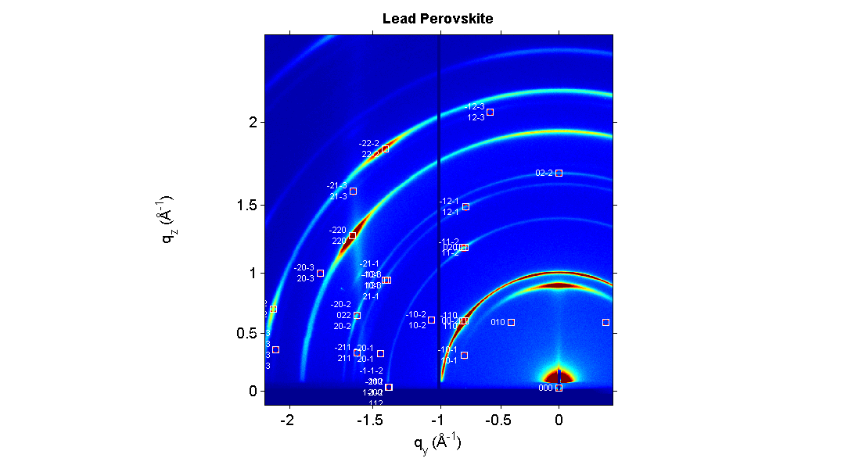
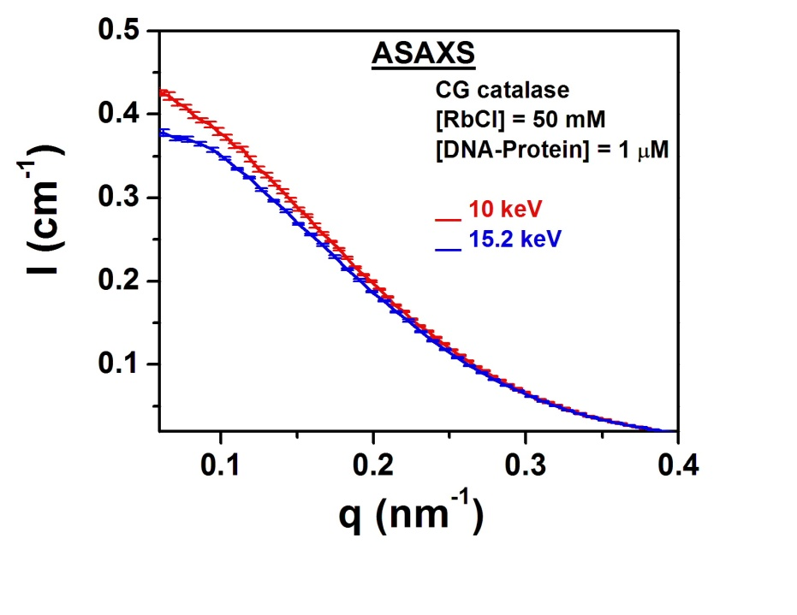
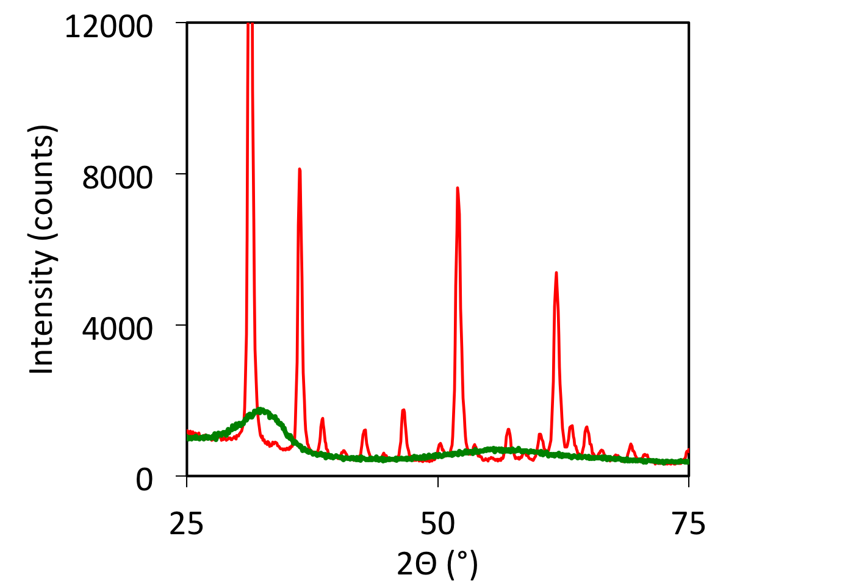

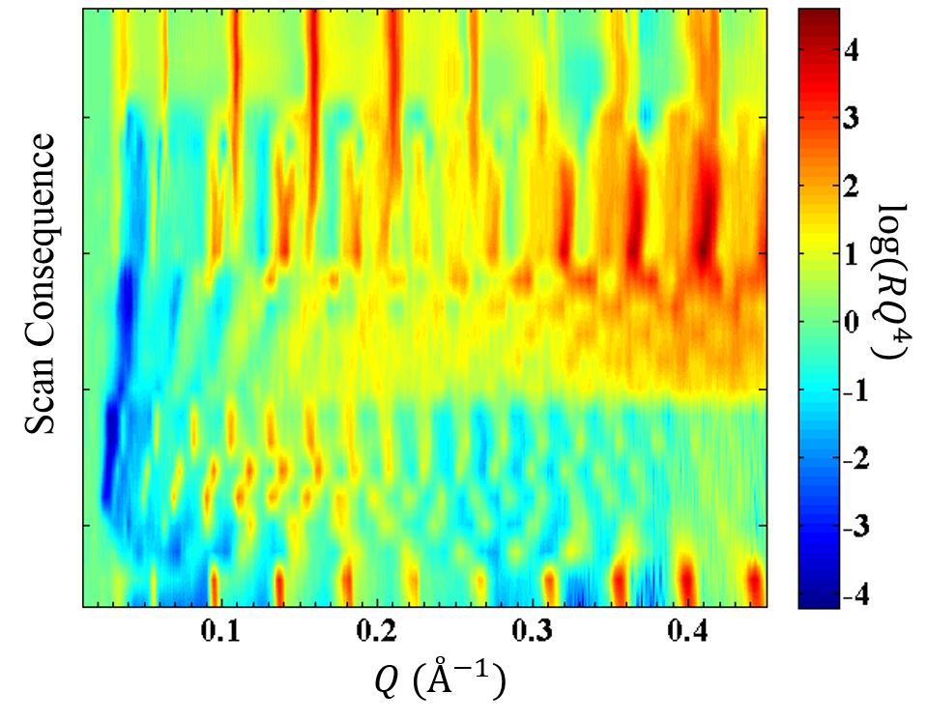
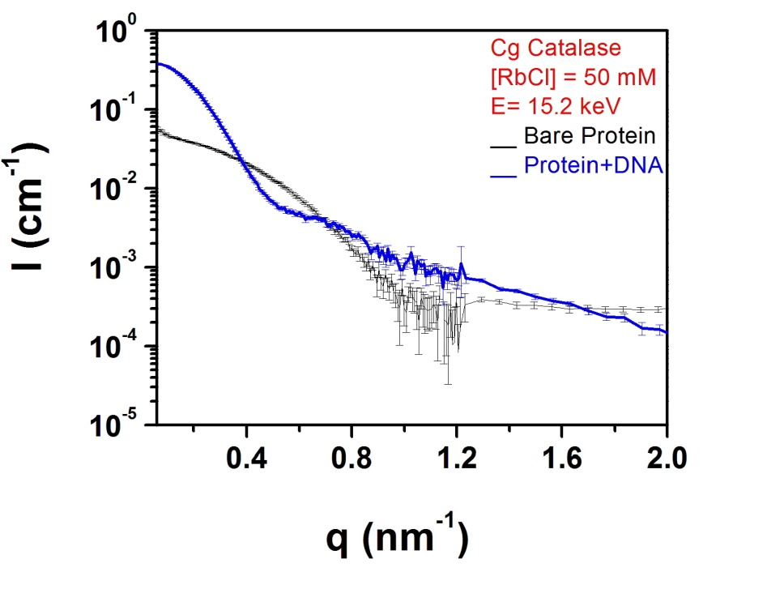
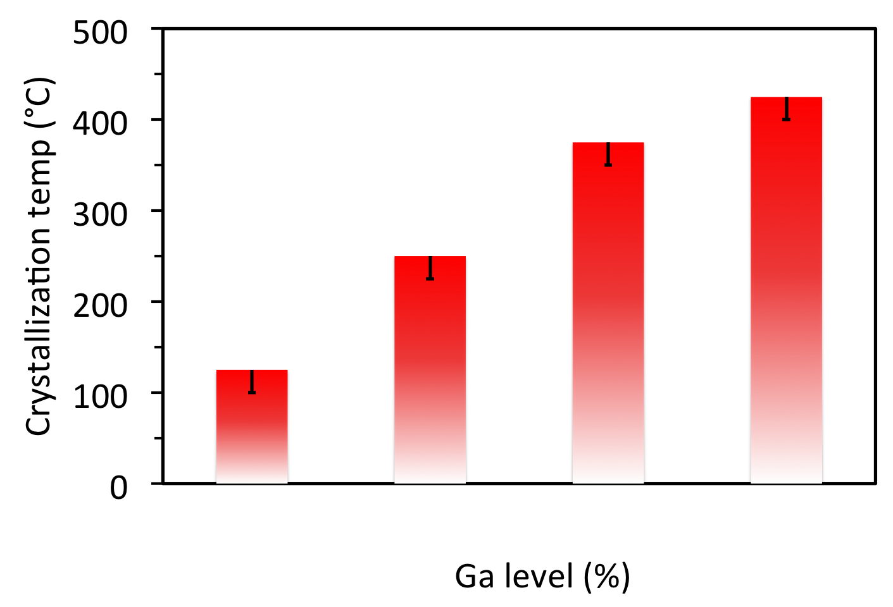
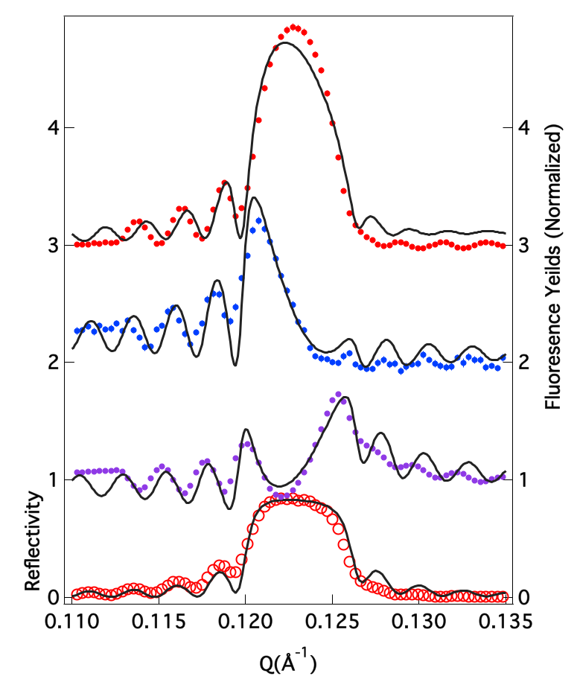
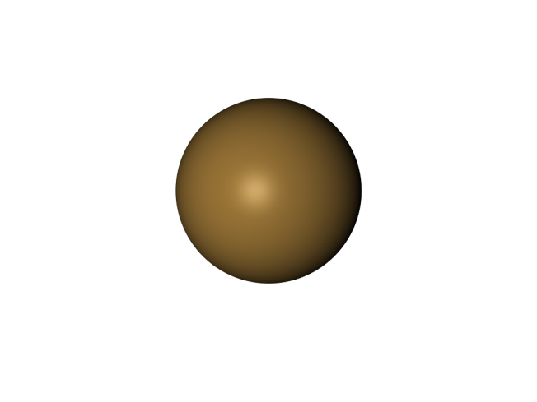
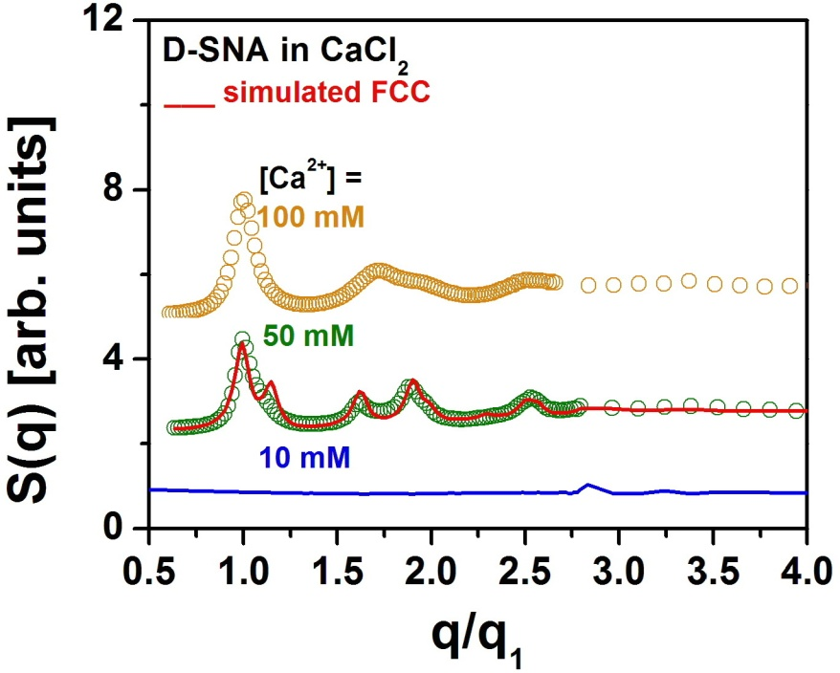
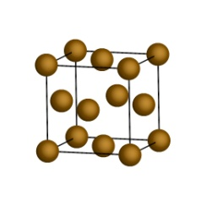
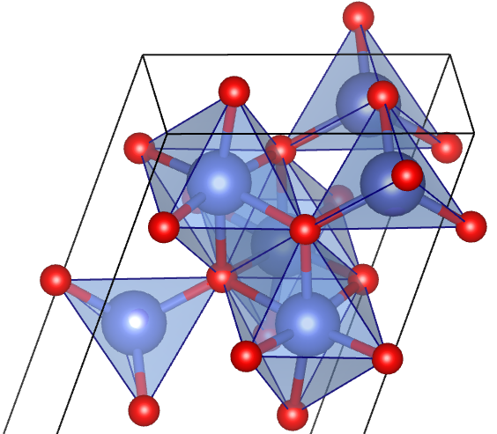
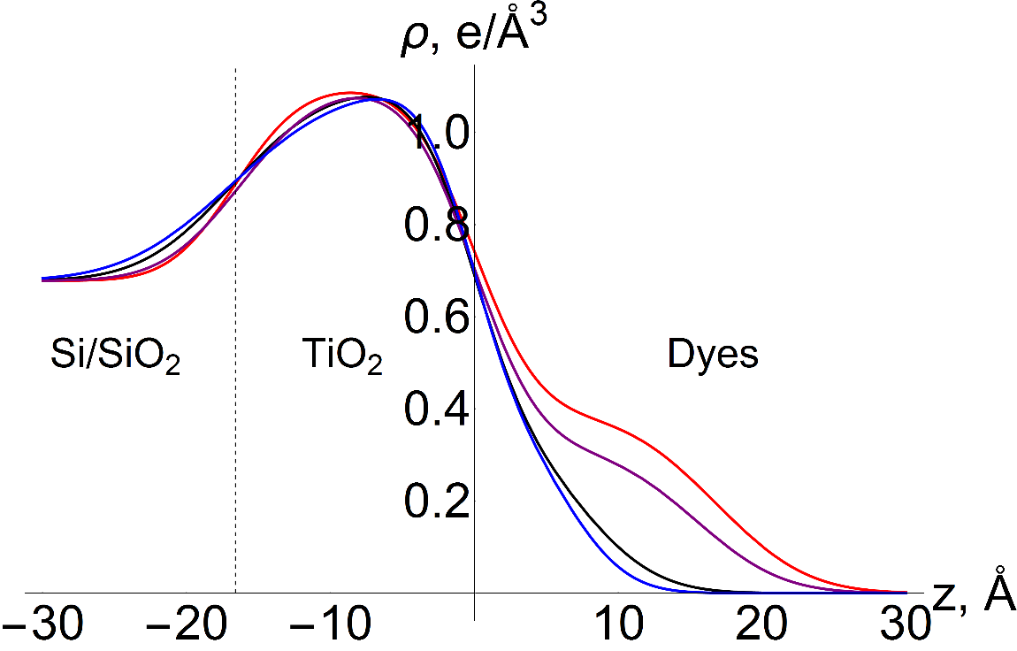
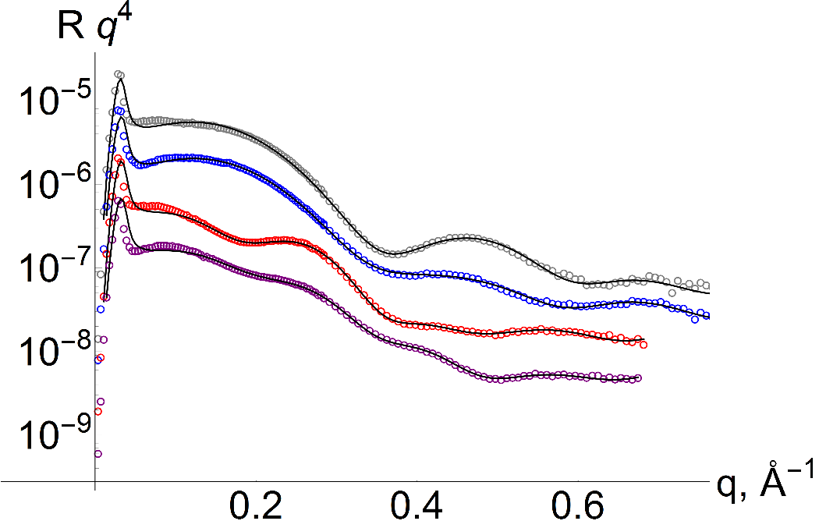
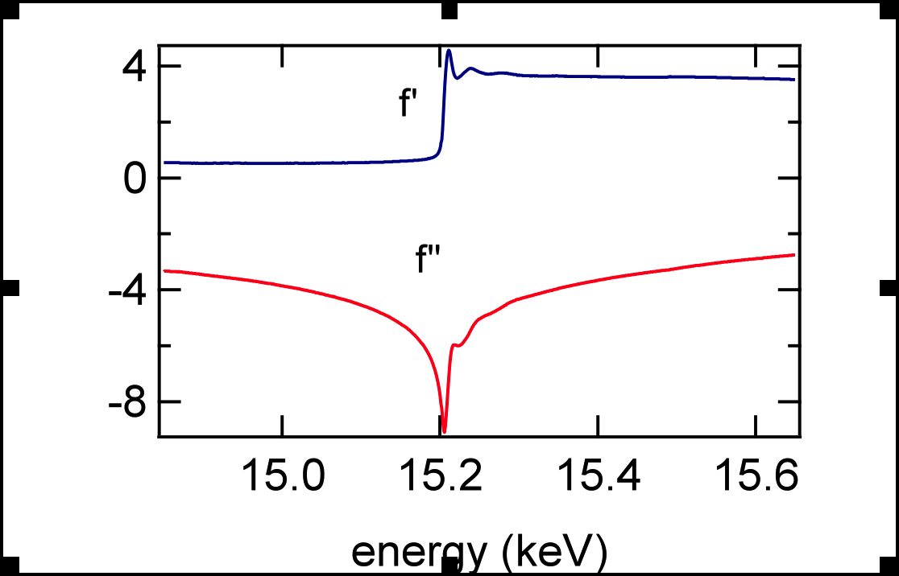
Bedzyk Research Group
X-ray Interface Science
Pd nanoparticles supported on SrTiO₃ nanocuboids
From Bottom Left:
Kurinji, Liane, Professor Michael J. Bedzyk, Bor-Rong, Stephanie, Janak, Xueting, Changrui, Allison, Xiao, Guena, Weishen, Sumit, Boris, Li, Gavin
Molecular assembly of amphiphilic binary mixtures:
Solution X-ray scattering studies
The morphology and catalytic performance of atomic layer deposition (ALD) grown Pd nanoparticle supported on SrTiO₃ nanocuboids with well-defined (001) surfaces that are either a TiO₂- or SrO- terminated surface.
The chemical state and local structure of Pd nanoparticle are measured by X-ray techniques
Pd
2-D intermolecular packing (2D hexagonal, rectangular-C, etc.) of amphiphilic binary mixtures is highly dependent on parameters like pH and lipid tail length, which can control the overall mesoscopic morphology of assembly: closed faceted vesicles or planar bilayer ribbons, by changing the local crystalline order of the amphiphile tails.
STO
STO
Pd
Local structure measured by extended X-ay absorption fine structure (EXAFS)
Chemical state measured by X-ay absorption near edge structure (XANES)
By using X-ray scattering, we can detect the structure of lipid assembly on multiple length scales, and study their phase transition behavior.
Wide Angle X-ray
Scatter (WAXS)
INTERFACIAL SCIENCE
by its very nature brings together a
diverse interests in oxide films, catalysis,
semiconductors, nano-science, bio-membranes,
surface physics, corrosion, and electrochemistry.
One of many grand challenges in the overall interdisciplinary field of interfacial science is the need
to observe and control the assembly of atoms,
molecules and supported nanoparticles at well-defined interfaces in complex environments.
With atomic resolution and high penetrating power,
we are developing and applying sophisticated
in situ X-ray methods to meet
these challenges.
With P. Stair (Chemistry), K. Poeppelmeier (Chemistry), and L. Marks (MatSci) groups
Small Angle X-ray
Scattering (SAXS)
Monitoring Ligand Substitution on PbS nanoparticles
XAFS Elucidates the Role of Trace Ag in Au Nanorod Growth
Our Approach: Create “timeline” of reaction
global structure
Oleate
20 Å
Electron Microscopy (EM)
X-Ray Fluorescence (XRF)
Extended X-Ray Absorption Fine Structure (EXAFS)
X-Ray Absorption Near Edge Structure (XANES)
6 Å
100 nm
200 nm
200 nm
200 nm
local structure
8 minutes
45 minutes
120 minutes
length = 9.6 nm
diameter = 6.3 nm
aspect ratio = 1.5
12 minutes
Thiocyanate
X-Ray Absorption
Fine Structure
(XAFS)
length = 23 nm
diameter =6.3 nm
aspect ratio = 3.6
length = 51 nm
diameter = 14 nm
aspect ratio = 3.7
length = 54 nm
diameter = 15 nm
aspect ratio = 3.7
oxidation state
3 Å
2.8 Å
highly anisotropic rods formed by 12 minutes in reaction time
reaction quenched using BSPP (bis(p-sulfanatophenyl)phenyl-phosphine)
Reaction Time
- x1000 expected increase in
hoping rate
- No conductivity across ~1cm
X-Ray Standing Wave (XSW)
XRF
EXAFS
PbS nanoparticles undergo quantum confinement in the infrared at small size-scales, which make them candidates for infrared LEDs and photo-detectors. Transport within nanoparticle films occurs electron hoping between neighboring nanoparticles. Conduction can be tailored by reducing particle to particle distance. One way to achieve this is by ligand substitution, wherein the native Oleate ligands are replaced with shorted Thiocyanate ligands reducing the gap space by 3 Angstroms and increasing hoping rate by several orders of magnitude. However, this process degrades the film which can be seen in SEM from crack formation and in GISAXS by the reduction of 2nd and 3rd order peak intensity. The result is that the film is none conductive over long length scales.
X-Ray Reflective (XRR)
Ag deposits early in the reaction on the nanorod surface and incorporates into bulk as the reaction progresses. When a high percentage of {110} surface atoms are Ag, the length growth rate exceeds the diameter growth rate. As Ag incorporates into bulk and is not on the surface, the length and diameter growth rates are equal by reaction completion.
Self-Assembled Nano-Dielectrics (SAND)
Effects of Ga on a-IGO crystallization
Energy Materials
X-Ray Studies of Solar Cells
Anomalous Small Angle X-Ray Scattering (ASAXS)
Determines the ion distribution around DNA-protein particles
Ultra thin high-k dielectric materials needed for low mobility organic semiconductor.
Amorphous indium oxide has higher mobility than other TFT semiconductoring layer materials however, it needs to be structurally stabilized
In situ X-ray Reflectivity (XRR): monitors thin film material morphology changes in special designed transmission cell.
Au
f’’
Rb⁺
Spiro-OMeTAD
f’
Alternating inorganic/organic layered structures
Low leakage current, high capacitance, solutions-process method, low deposition T
Samples were annealed for 1 hour in 25°C increments. Glancing incidence X-ray diffraction monitors the transition from amorphous to crystalline film
Ge/Ti multi-layer
CH₃NH₃PbI_{3-x}Cl_{x}
+ TiO₂
Compact TiO₂
E - E_{binding}
0
Energy (keV)
= Br ⁻
FTO
Through probing the scattering pattern at energies below and at the Rb K absorption edge, the ion distribution around the proteins can be extracted. This has important implications on the extent of the DNA shell, the higher melting temperatures associated with the constructs, and resistance to enzymatic degradation.
GIWAXS of Lead perovskite showing texturing and residual PbI₂ (smallest ring)
SAXS probes electrolyte-mediated assembly of SNA-Au NPs
Four homologue dyes for Solar cells
Electrolyte-mediated assembly
Ga is seen to increases the crystallization temperature
9 nm
SH-TTTT….TTTT
Disordered
Gas-like
FCC
Glass-like
EXAFS Samples: | N | R: Ga-O (Å)
c-Ga₂O₃ (model) | 5 | 1.85, 2.01
a-Ga-O | 4.3 | 1.88
Ga doped a-In-O | 3.9 | 1.88
X-ray Reflectivity (XRR) curves for dye monolayers
Au
40 bases (T40)
FCC
Density profiles of dyes on thin TiO₂ deduced from XRR
ss-DNA-AuNP (S-SNA)
Gas-like
I_{s}
Long-period XSW generated by layered Synthetic Microstructure (Si/Mo multilayers).
Sensitive to heavy elements
Capable of probing elemental position w/ sub-nanometer resolution.
Ga-O bond distance is consistently between that of 4-fold coordinate Ga and 6-fold coordinate Ga. Ga’s ability to increase crystallization temperature is attributed to presence of 4-fold sites.
DNA-Au NPs can assemble into organized structures in the absence of Watson-Crick base pairing using electrostatics alone in high ionic strength conditions. At lower ionic strength, the particles show no inter-particle interaction, or a “gas-like” phase. As the ionic strength is increased, the DNA-Au NPs assemble into a close-packed FCC structure. As the ionic strength is increased to even higher values, the structure loses its order, and a glass-like phase is observed, which is most accurately modeled as hexagonal random packing.

